Slide 1

Electricity Billing-System
GUI Project PowerPoint Presentation

Slide 2
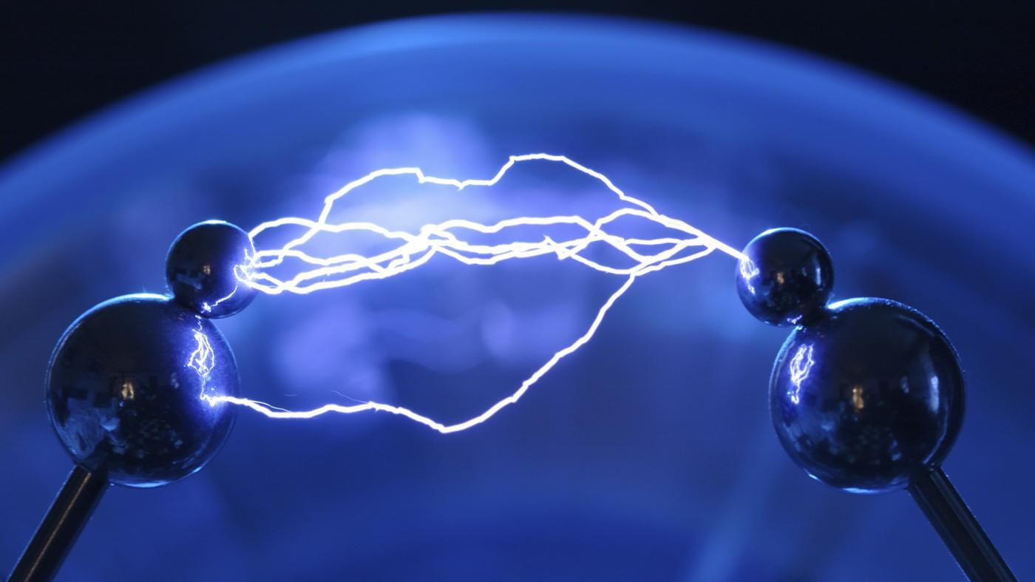
HOME
EXECUTIVE ENGINEER
FIELD MANEGER
CUSTOMER
EXIT

Slide 3
HOME
EXECUTIVE ENGINEER
EXECUTIVE ENGINEER
FIELD MANEGER
CUSTOMER
EXIT

Slide 4
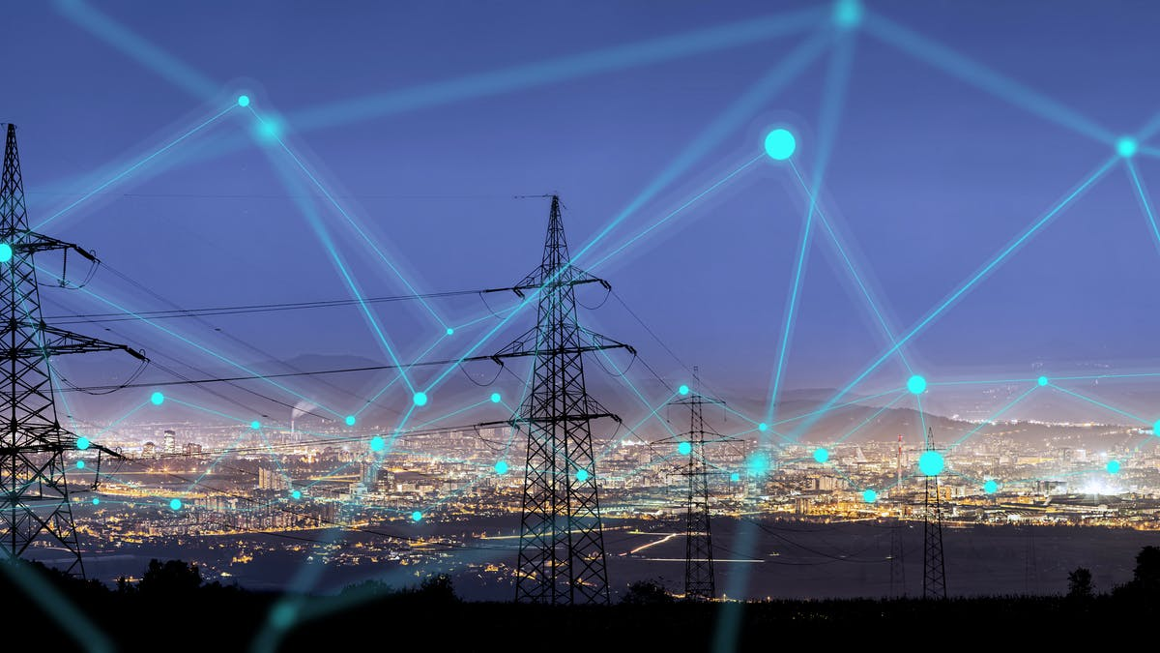

ADMIN :
PASSWORD:
CANCEL
LOGIN
LOG IN PANEL OF EXECUTIVE ENGINEER

Slide 5
**** *** ****
ADMIN:
PASSWORD:
CANCEL
LOGIN
LOGIN
LOG IN PANEL OF EXECUTIVE ENGINEER

Slide 6
EXECUTIVE ENGINEER DASHBOARD
APPROVE BILL
FIELD MANEGER INFO
ADD FIELD MANEGER
LOG OUT

Slide 7
Name Meter No Address NID no Registered Date
Rehnuma
57689495
30/1 Bashabo, Dhaka
480 013 3575
18 AUG 2020
Ariyan
73839393
55/9 Uttara, Dhaka
990 645 7382
12 May 2020
Raiyan
68483839
77/9 Mirpur, Dhaka
667 456 9429
07 June2020
Raiyan
68483839
77/9 Mirpur, Dhaka
667 456 9429
07 June2020
Raiyan
68483839
77/9 Mirpur, Dhaka
667 456 9429
07 June2020
Enter ID:
APPROVE BILL
< Back

Slide 8
Name Meter No Address NID no Registered Date
Rehnuma
57689495
30/1 Bashabo, Dhaka
480 013 3575
18 AUG 2020
Ariyan
73839393
55/9 Uttara, Dhaka
990 645 7382
12 May 2020
Raiyan
68483839
77/9 Mirpur, Dhaka
667 456 9429
07 June2020
Raiyan
68483839
77/9 Mirpur, Dhaka
667 456 9429
07 June2020
Raiyan
68483839
77/9 Mirpur, Dhaka
667 456 9429
07 June2020
< Back

Slide 9
FIELD MANEGER INFO
USER NAME
:
ADDRESS
:
NID NO
:
REGISTERED DATE
:
SAVE
CANCEL

Slide 10
Name Address NID no Registered Date
*******
*******
*******
*******
*******
*******
*******
*******
*******
*******
*******
*******
*******
*******
*******
*******
*******
*******
*******
*******
*******
*******
*******
*******
Enter ID:
Update
Delete
< Back

Slide 11
FIELD MANEGER INFO
USER NAME
:
******************
ADDRESS
:
*******************
NID NO
:
******************
REGISTERED DATE
:
********************
UPDATE
CANCEL

Slide 12
FIELD MANEGER INFO
USER NAME
:
*******************
ADDRESS
:
************************
UPDATED SUCCESFULLY
:
OK
NID NO
:
************************
REGISTERED DATE
:
*************************
UPDATE
CANCEL

Slide 13
FIELD MANEGER INFO
USER NAME
********
:
ADDRESS
:
Are you sure?
*********
NID NO
Yes
No
:
**********
REGISTERED DATE
:
*********
DELETE
CANCEL
DELETE

Slide 14
FIELD MANEGER INFO
USER NAME
:
*******
ADDRESS
:
Are you sure?
*******
Yes
No
NID NO
**********
:
REGISTERED DATE
:
**********
DELETE
CANCEL
DELETE

Slide 15
HOME
EXECUTIVE ENGINEER
FIELD MANEGER
CUSTOMER
EXIT

Slide 16
**** *** ****
ADMIN:
PASSWORD:
CANCEL
LOGIN
LOGIN
LOG IN PANEL OF FIELD MANEGER

Slide 17
FIELD MANEGER DASHBOARD
ISSUE BILL
CUSTOMER INFO
ADD CUSTOMER
LOG OUT

Slide 18
BILLING SYSTEM
Admin Name
:
Issue Date
USER DETAILS
:
Billing Month
:
SHOW MORE DETAILS
Due Date
:
Total Energy Charges
:
Previous Dues
:
Vat
:
Total Bill
REQUEST FOR APPROVAL
CANCEL
:

Slide 19
CUSTOMER DETAILS
BILLING MONTHS
Name:
Rehnuma
MONTH | BILL | DUES
****** | **** | --
****** | **** | --
****** | **** | --
****** | **** | --
****** | **** | --
****** | **** | --
****** | **** | --
Register Date:
18 AUG 2020
Meter No.:
57689495
Address:
30/1 Bashabo, Dhaka
NID:
480 013 3575
< Back

Slide 20
FIELD MANEGER DASHBOARD
ISSUE BILL
CUSTOMER INFO
ADD CUSTOMER
LOG OUT

Slide 21
CUSTOMER INFO
USER NAME
:
METER NO
:
ADDRESS
:
NID NO
:
REGISTERED DATE
:
SAVE
CANCEL

Slide 22
FIELD MANEGER DASHBOARD
ISSUE BILL
CUSTOMER INFO
ADD CUSTOMER
LOG OUT

Slide 23
Name Meter No Address NID no Registered Date
Action
Rehnuma
57689495
30/1 Bashabo, Dhaka
480 013 3575
18 AUG 2020
Update
Delete
Ariyan
73839393
55/9 Uttara, Dhaka
990 645 7382
12 May 2020
Update
Delete
Raiyan
68483839
77/9 Mirpur, Dhaka
667 456 9429
07 June2020
Update
Delete
Raiyan
68483839
77/9 Mirpur, Dhaka
667 456 9429
07 June2020
Update
Delete
Raiyan
68483839
77/9 Mirpur, Dhaka
667 456 9429
07 June2020
Update
Delete
Enter ID:
Update
Delete
< Back

Slide 24

CUSTOMER INFO
USER NAME
:
REHNUMA
METER NO
:
57689495
ADDRESS
:
30/1 Bashabo,Dhaka
NID NO
480 013 3575
:
REGISTERED DATE
:
18 AUG 2020
UPDATE
UPDATE
CANCEL

Slide 25
CUSTOMER INFO
USER NAME
Ariyan
:
METER NO
Are you sure?
:
73839393
Yes
No
ADDRESS
:
55/9 Uttara, Dhaka
NID NO
990 645 7382
:
REGISTERED DATE
:
12 May 2020
DELETE
CANCEL
DELETE

Slide 26
FIELD MANEGER DASHBOARD
ISSUE BILL
CUSTOMER INFO
ADD CUSTOMER
LOG OUT

Slide 27

USER:
PASSWORD:
CANCEL
LOGIN
LOG IN PANEL OF CUSTOMER

Slide 28
USER DASHBOARD
SHOW PROFILE
Electricity Bill
LOG OUT

Slide 29
PROFILE DETAILS
NAME
:
REHNUMA
METER NO
:
57689495
ADDRESS
:
30/1 Bashabo,Dhaka
NID NO
480 013 3575
:
REGISTERED DATE
18 AUG 2020
:
< Back

Slide 30
USER DASHBOARD
SHOW PROFILE
Electricity Bill
LOG OUT

Slide 31
Electricity BILL
Name
Pay Bill
:
Issue Date
:
Due Date
:
Total Energy Charges
:
Previous Dues
:
Cancel
Vat
:
Total Bill
:
Billing Month
:

Slide 32
WELCOME

